Slide 1

E-Commerce
Web Programming
Shukirillaev Mukhammadsodik
ID: 202438379

Slide 2
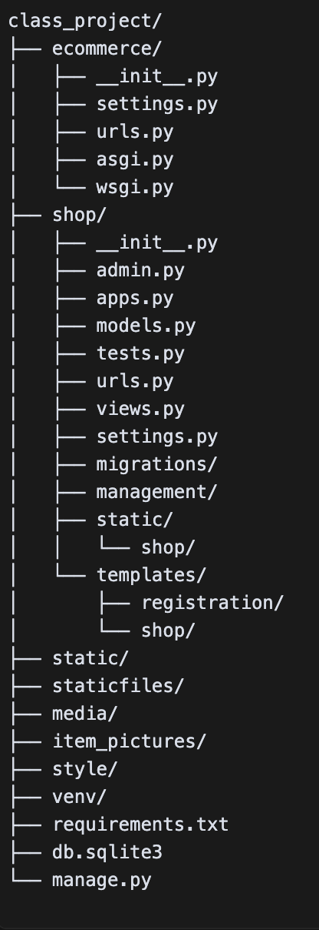
ShopSmart: A Modern Django-Powered E-commerce Experience
Reflects the project's core features:
Here is the whole structure of the project
- User authentication
- Product categorization
- Shopping cart functionality
- Image handling
- Responsive design
Technology Stack
- Django 5.0.1;
- Python;
- SQLite Database;
- Pillow (Image Processing);
- HTML/CSS/JavaScript;
- Bootstrap;

Slide 3
Django 5.0.1
- High-level Python web framework that follows the Model-View-Template (MVT) pattern;
- Provides built-in security features, admin interface, and ORM
(Object-Relational Mapping);
Handling:
- URL routing (as seen in urls.py);
- Template rendering (using base.html and other templates);
- Database operations through models;
- User authentication and session management;

Slide 4
Python, the fundamental programming language employed throughout the project, serves as the backbone for all backend logic, encompassing the following functionalities:
- View functions defined in views.py;
- Model definitions;
- Business logic;
- Data processing;
Utilizing SQLite Database, a lightweight and serverless database, the project effectively stores the following data:
- Product information;
- User data;
- Cart items;
- Order history;
Django’s ORM facilitates seamless management of the database, enabling straightforward execution of CRUD operations.

Slide 5
Main Project Structure
- ecommerce/ - The main project directory;
- shop/ - The main application directory;
- manage.py - Django's command-line utility for administrative tasks;
- db.sqlite3 - The SQLite database file;
- requirements.txt - Python package dependencies;
- Pipfile - Pipenv dependency management file
Static and Media Files:
- static/ - Directory for static files (CSS, JavaScript, images);
- staticfiles/ - Collected static files (generated by collectstatic);
- media/ - Directory for user-uploaded files;
- item_pictures/ - Directory for product images

Slide 6
Pillow (Image Processing):
- A Python imaging library that handles image processing
Here it is used for:
- Processing product images
- Image resizing and optimization
- Thumbnail generation
HTML/CSS/JavaScript:
- HTML: Used for structuring web pages (as seen in base.html)
- CSS: Styling application (referenced in style.css)
- JavaScript: Adding interactivity, like:
- Cart updates without page refresh
- Dynamic content loading
- Form validation
- User interface enhancements

Slide 7
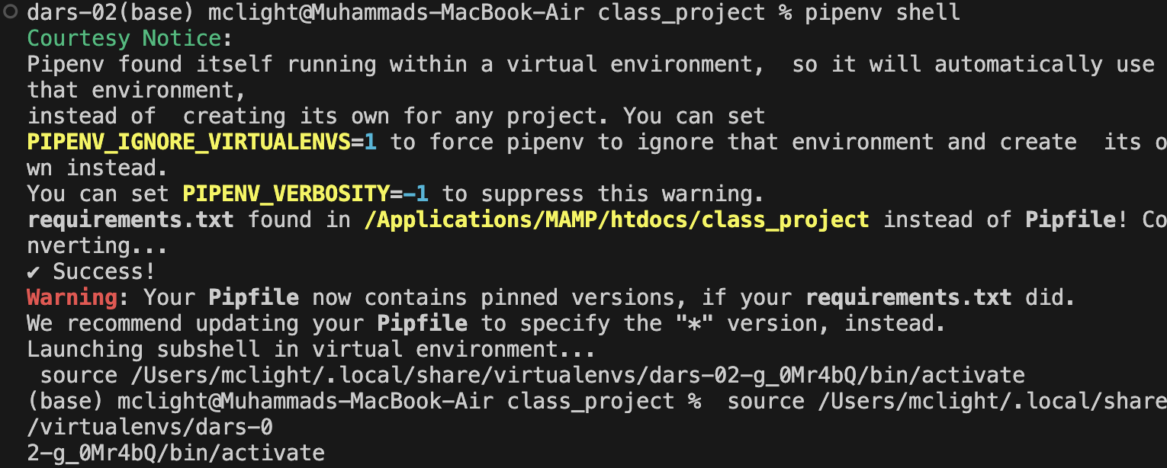
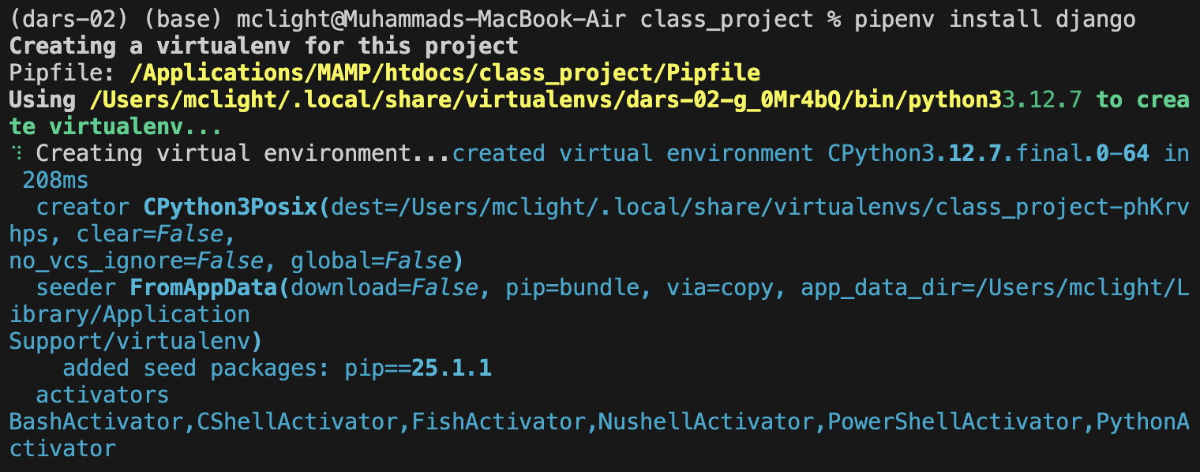
Activate the virtual environment
Project Setup & Environment
Install Django in environment

Slide 8
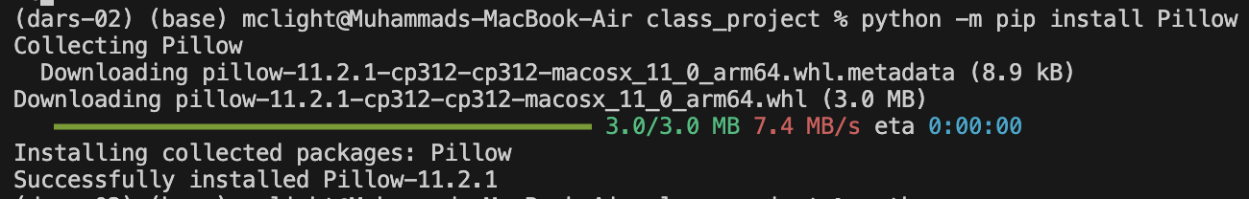
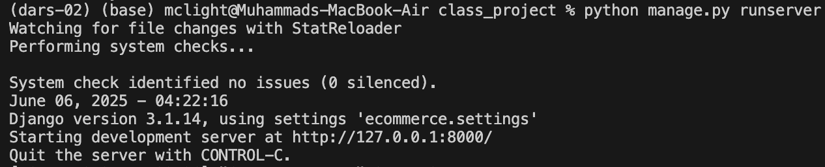
Project Setup & Environment
Installing Pillow
Finally, run the development server:

Slide 9
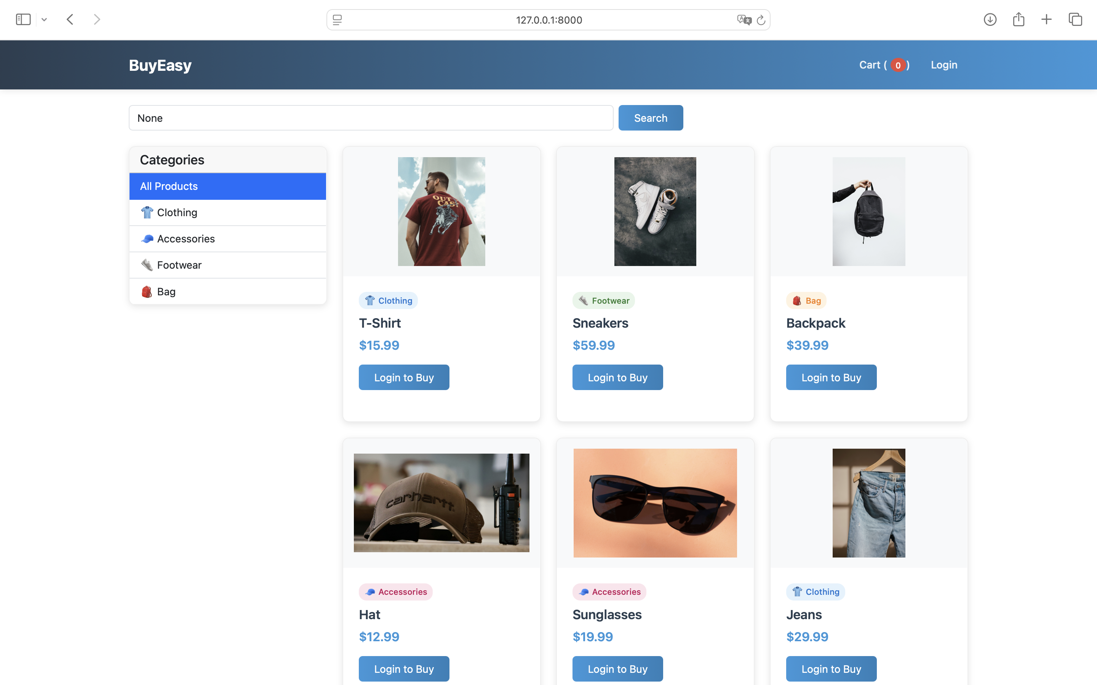
Main Page
You need to login to buy

Slide 10
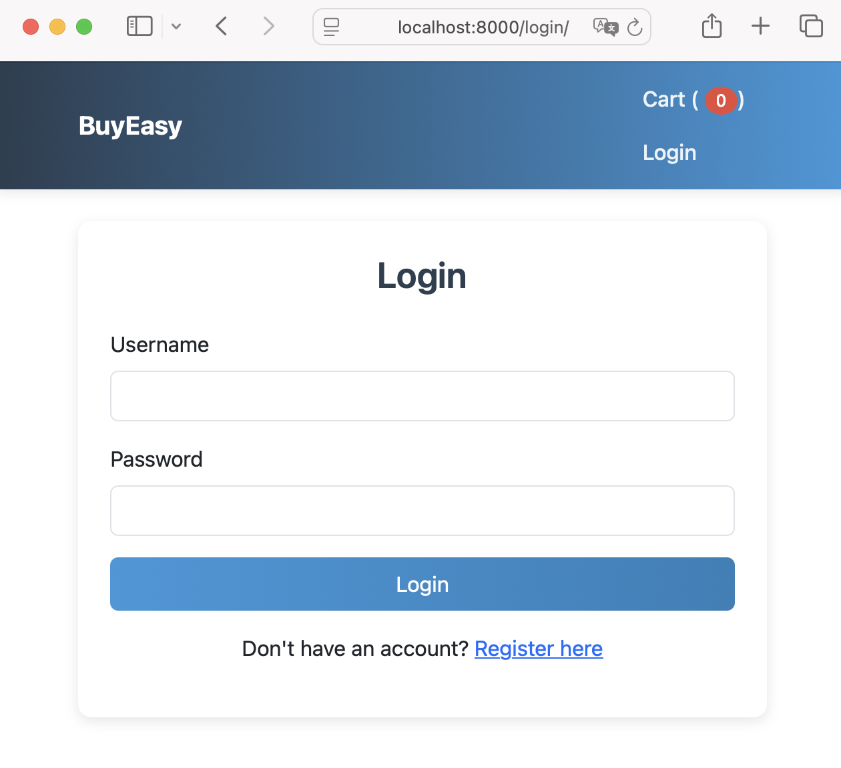
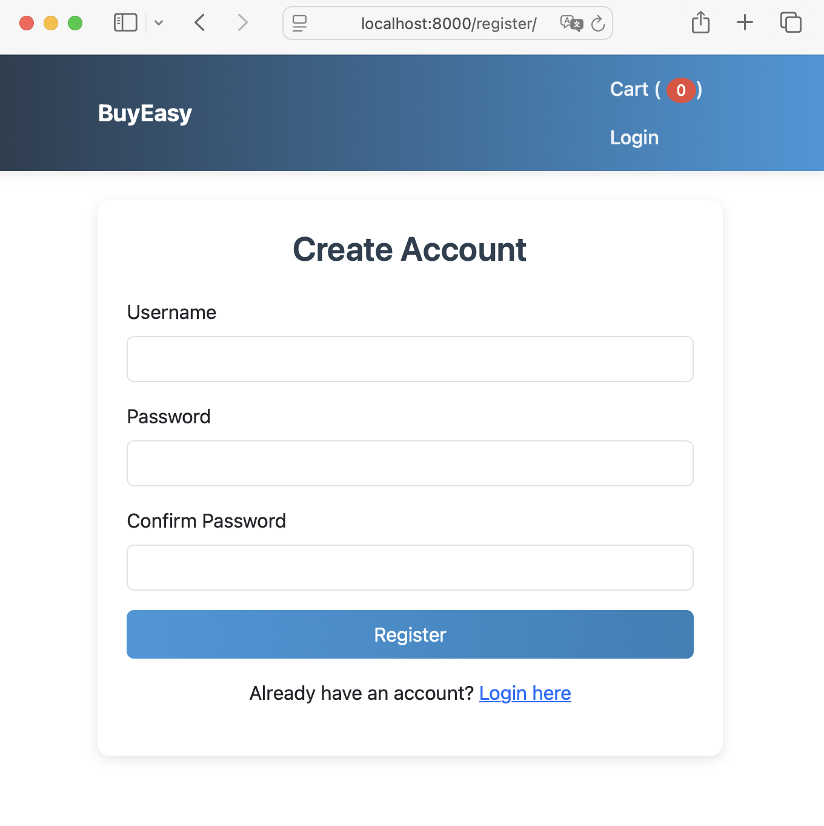
Login & Register

Slide 11
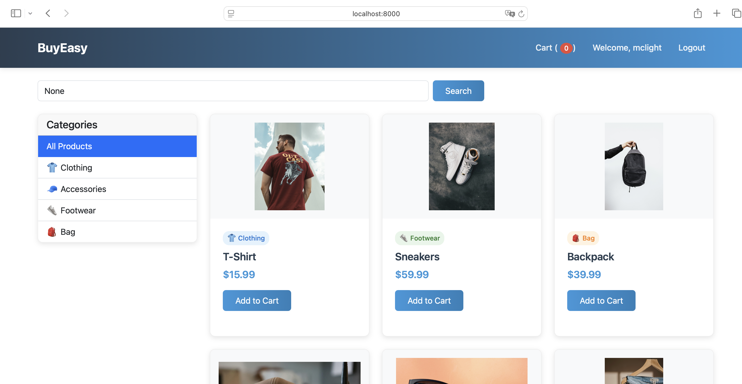
Home Page

Slide 12
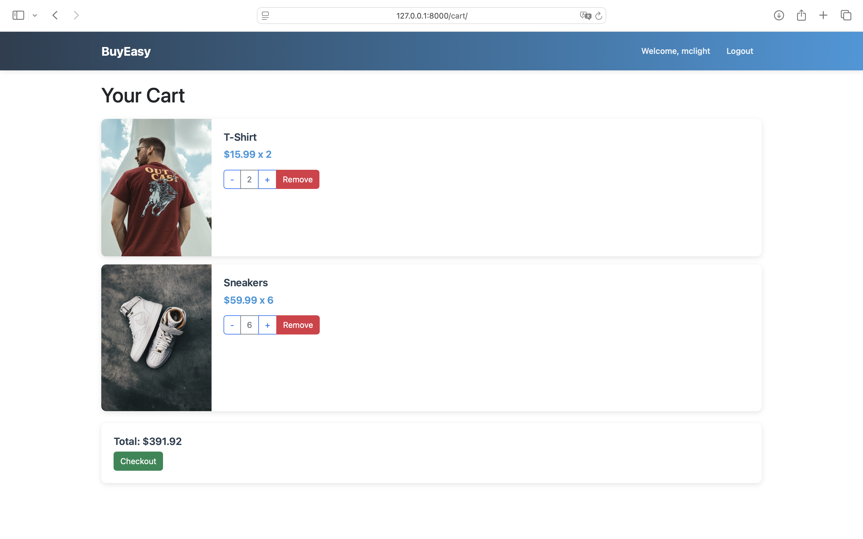
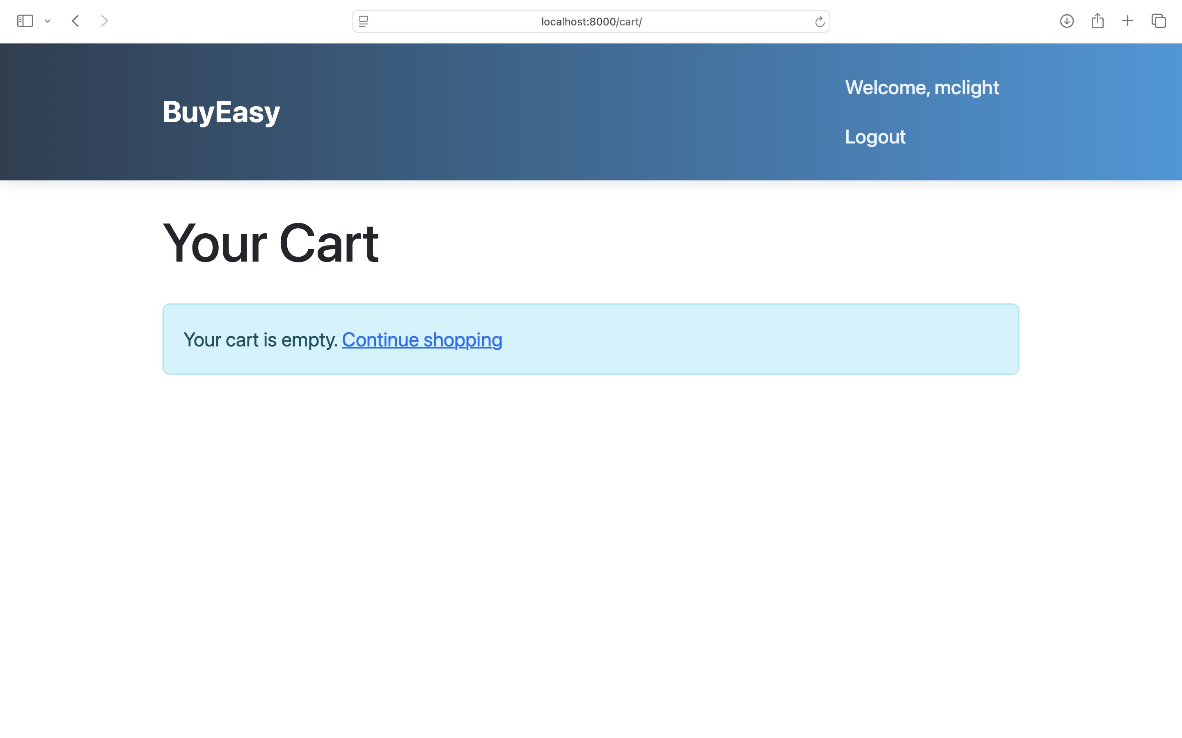
Cart

Slide 13
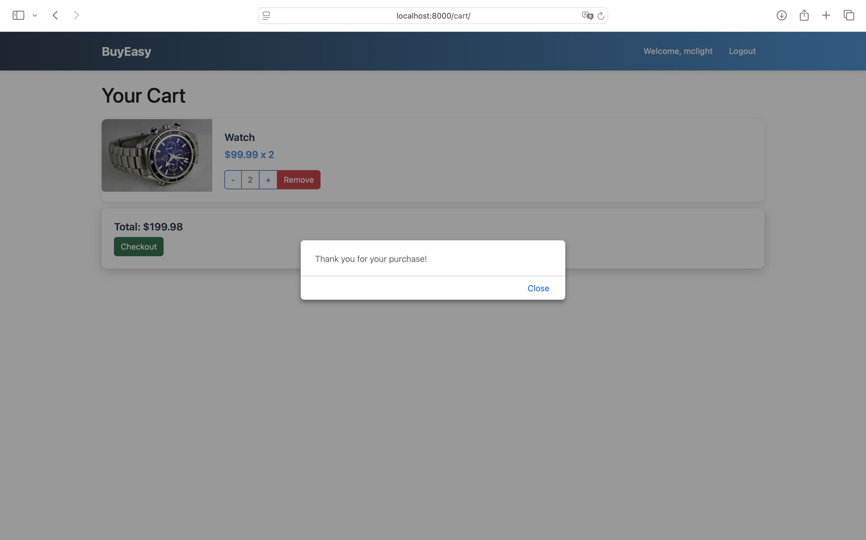
Purchase

Slide 14
The stack works together as follows:
- Django handles the backend logic and database operations;
- Python processes the business logic;
- SQLite stores all the data;
- Pillow processes images;
- HTML/CSS/JavaScript with Bootstrap creates a responsive, user-friendly interface;
All these components are integrated through Django's template system and static file handling

Slide 15
User Authentication
- Uses Django's built-in authentication system;
Features:
- User registration (register view);
- Login/Logout functionality;
- Protected routes using @login_required decorator;
- User-specific cart and orders;
Product Management
a) Models:
- Product model with fields for name, price, image, description;
- Category model for product categorization;
b) Features:
- Product listing with filtering;
- Category-based filtering;
- Search functionality;
- Product details view;

Slide 16
Shopping Cart
Models:
- CartItem model linking users to products
Features:
- Add to cart;
- Update quantities;
- Remove items;
- Cart total calculation;
- Real-time cart updates using AJAX;
Order Processing
Features:
- Checkout process;
- Cart clearing after successful order;
- Order history (implied by the structure);

Slide 17
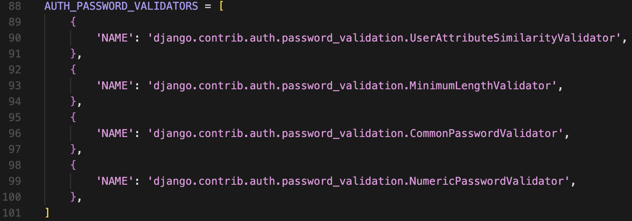
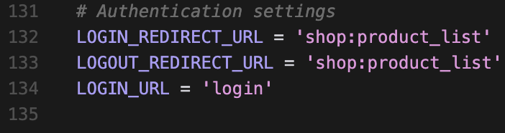
Uses Django's built-in authentication system
Password validation rules:
Login/Logout redirects configured:

Slide 18
Planned Features
A. Enhanced User Experience
User Profiles:
- Order history;
- Saved addresses;
- Wishlist functionality;
- Personal preferences;
Advanced Search:
- Filters (price range, size, color);
- Sort options;
- Saved searches;
Reviews and Ratings:
- Product reviews;
- User ratings;
- Photo reviews;
- Review moderation;
B. Payment and Checkout:
Multiple Payment Gateways:
- Stripe;
- PayPal;
- Apple Pay/Google Pay;
Advanced Checkout:
- Guest checkout;
- Save for later;
- Multiple shipping addresses;
Order Tracking:
- Real-time tracking
- Shipping notifications
- Delivery estimates
C. Inventory Management
Stock Management:
- Low stock alerts;
- Back-in-stock notifications;
- Bulk inventory updates;
Variant Management:
- Size variants;
- Color options;
- Custom product options;

Slide 19
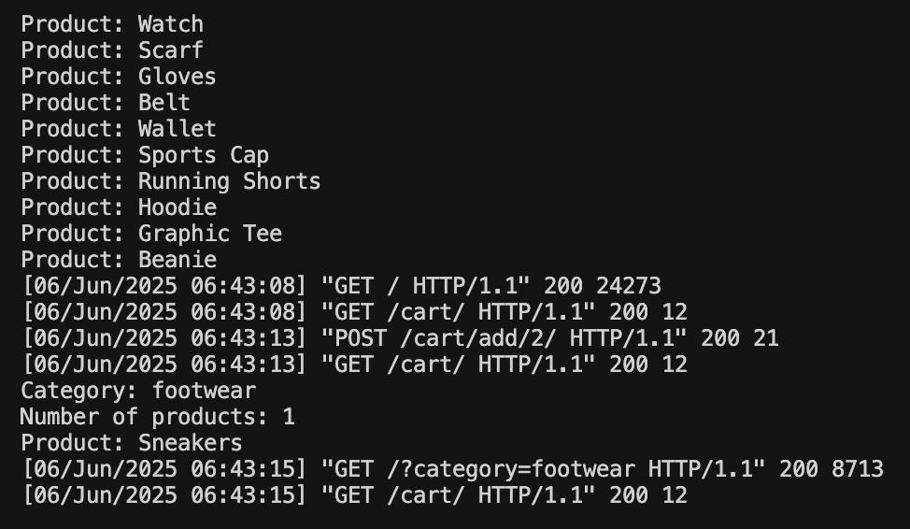
In terminal, let’s understand what they are sending:
This is the timestamp of when the request was received and processed by the server.
This is the HTTP status code returned by the server. 200 means "OK" or "Success", indicating that the request was successfully processed and the server provided the requested resource.
The response body size was 24273 bytes.
The response body size was 12 bytes.
This is a query string. It's used to pass parameters to the server as part of the URL. In this case, a parameter named category is being sent with the value footwear.

Slide 20
Demo
https://github.com/McLight-Note/Web_Programming-Class_Project/tree/main/class_project

Slide 21
References
My Github:
https://github.com/McLight-Note/Web_Programming-Class_Project/tree/main/class_project
JavaScript Course:
https://www.youtube.com/watch?v=Ihy0QziLDf0&list=PLZPZq0r_RZOO1zkgO4bIdfuLpizCeHYKv
Django Course:
https://www.youtube.com/watch?v=3EzKBFc9_MQ&list=PL4cUxeGkcC9iqfAag3a_BKEX1N43uJutw
ChatGPT

Slide 22
Thank you
Everyone
Shukirillaev Mukhammadsodik

